Slide 1
Measurement the effect physical factors on the rate of photosynthesis by leaf disc method
Experiment Incharge
Zaiba Hasan Khan
2014PHXF0426P

Slide 2
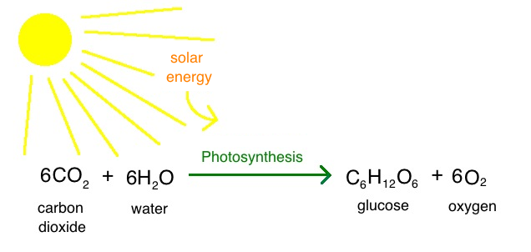
Photosynthesis
In photosynthesis, plants use energy from the sun, water, and carbon dioxide (CO₂) from the air to store carbon and energy in the form of glucose molecules.
Oxygen gas (O₂) is a byproduct of this reaction. Oxygen production by photosynthetic organisms explains why earth has an oxygen-rich atmosphere.
The equation for photosynthesis can be written as follows:
6CO₂ + 6H₂O + light energy → C₆H₁₂O₆ + 6O₂
Most plants, most algae, and cyanobacteria perform photosynthesis; such organisms are called photoautotrophs.

Slide 3
Process begins when energy from light is absorbed by proteins called reaction centres that contain green chlorophyll pigments.
In plants, these proteins are held inside organelles called chloroplasts, which are most abundant in leaf cells.
In these light-dependent reactions, some energy is used to strip electrons from suitable substances, such as water, producing oxygen gas. The hydrogen freed by the splitting of water is used in the creation of two further compounds that act as an immediate energy storage means: reduced nicotinamide adenine dinucleotide phosphate (NADPH) and adenosine triphosphate (ATP), the "energy currency" of cells.
In the leaf-disk assay, all of the components necessary for photosynthesis are present. The light source provides light energy, the solution provides water, and sodium bicarbonate provides dissolved CO₂

Slide 4
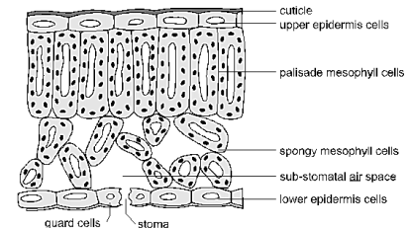
Structure of Leaf
Plant material will generally float in water. This is because leaves have air in the spaces between cells, which helps them collect CO2 gas from their environment to use in photosynthesis.
When you apply a gentle vacuum to the leaf disks in solution, this air is forced out and replaced with solution, causing the leaves to sink.
When you see tiny bubbles forming on the leaf disks during this experiment, you’re actually observing the net production of O₂ gas as a byproduct of photosynthesis. Accumulation of O₂ on the disks causes them to float. The rate of production of O₂ can be affected by the intensity of the light source, but there is a maximum rate after which more light energy will not increase photosynthesis.
The white oval in the center of each cell represents a vacuole which is filled with water with dissolved substances. The dark spots in the mesophyll cells represent chloroplasts

Slide 5
To determine the net rate of photosynthesis, one could measure one of the following:
Production of O2
Consumption of CO2
The difficulty related to measuring the production of oxygen is compounded by the complementary process of aerobic respiration consuming oxygen as it is produced.
Therefore, measuring oxygen production is equivalent to measuring net photosynthesis.
Factors affecting the rate of photosynthesis
Light intensity
Carbon dioxide concentration
Temperature

Slide 6
Materials
Leaves
Syringe without needle
Punch machine/straw/micro pipette tip
Sodium bicarbonate
Beaker
Detergent
Incandescent or 100-watt equivalent lightbulb in fixture (preferably with a clamp)

Slide 7
Procedure
Take two beakers, Add 0.2% bicarbonate solution in one beaker and in another one add 100 mL water. Add a few drops of liquid dish soap to each beaker and mix gently, trying to avoid making suds in the solution.(Water here is used as a blank)
Using the straw or punching machine, cut out 10 circles from the leaves (use 10 more discs for blank)
Remove the plunger from the syringe, and remove the cover from the tip, if there is one. Put the leaf disks into the barrel of the syringe, and tap them down to the tip of the syringe.
Replace the plunger into the syringe, push it down to about the 1 mL mark, being careful not to squash the leaf pieces.
Draw about 5-6 mL of bicarbonate solution into the syringe. The leaf disks should float in the solution
Hold the syringe with the tip up, and expel the air by gently pushing on the plunger.
Plug the tip of the syringe tightly with your finger, and gently pull on the plunger, creating a slight vacuum. You should see tiny bubbles coming out of the leaf disks. Hold the vacuum for a few seconds, and then release the plunger, letting it snap back. Some of the disks should begin to sink(Note: Put your thumb over the tip of the syringe, and pull back slowly on the plunger to about the 10 mL mark. This creates a vacuum, and pulls air out of the leaf)

Slide 8
Repeat the previous step several times, until all of the disks have sunk to the bottom of the solution (tap on the plunger to release the bubbles in order to make all the leaf disks sink)
When all the leaf disks have settled to the bottom of the solution, carefully remove the plunger and pour the disks and sodium bicarbonate solution into each beaker. They should settle to the bottom of the cup. If any leaf disks float, remove them from the beaker
Simultaneously, do this for blank also
Set up the light fixture so that it is suspended about 12 inches (30 cm) above the table. You may want to use a ring stand for this
Place both the beakers under a bright light fixture
At the end of each minute, record the number of floating disks (any disk that is no longer touching the bottom). You will measure how long it takes (in seconds) for the disks to float as a way to measure the rate of photosynthesis.

Slide 9
Observations Number of Floating Leaf Disks
Minutes | 1 | 2 | 3 | 4 | 5 | 6 | 7 | 8 | 9 | 10 | 11 | 12 | 13 | 14 | 15 | 16 | 17 | 18 | 19 | 20
In water
In bicarbonate solution

Slide 10
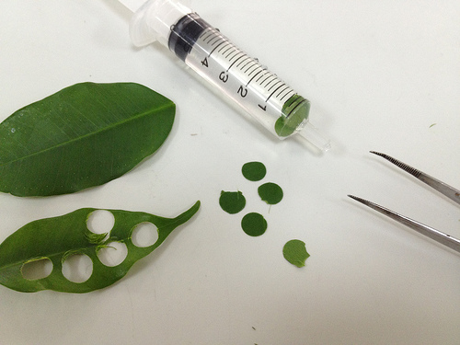
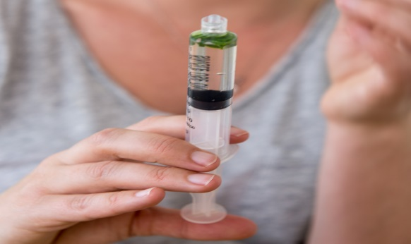
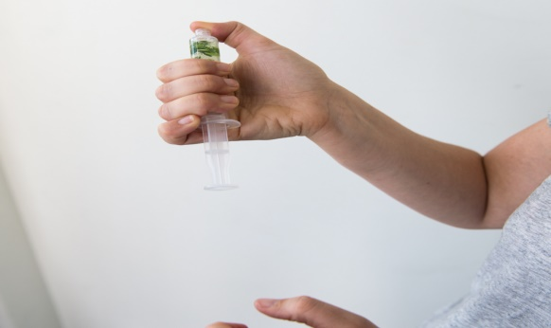
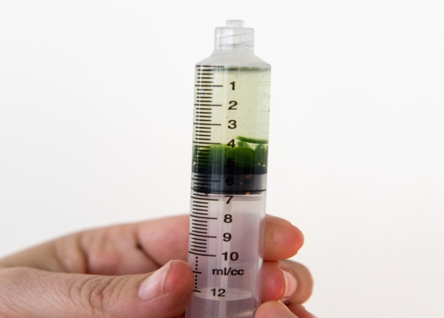
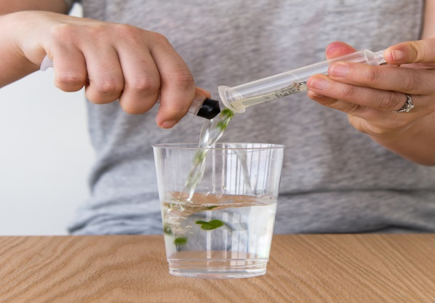
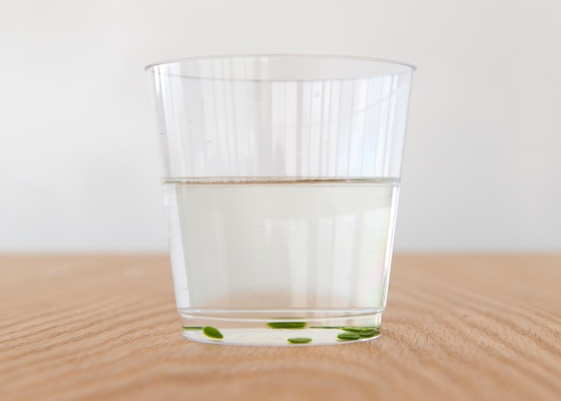
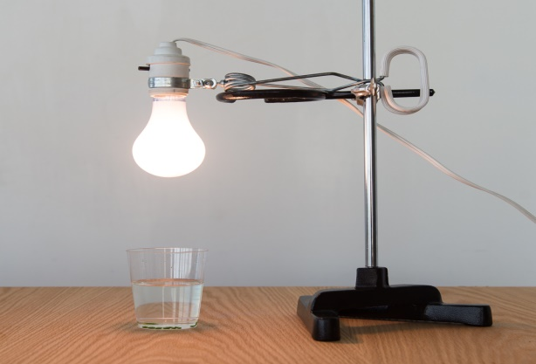
1.
2.
3.
4.
5.
6.
1.Punch the leaf(10 discs)
2.Add 5-6 mL Sodium bicarbonate solution (leaf discs should be floated in the solution)
3. Create the vacuum using thumb
4.Leaf discs should be sink into the solution inside the syringe
5.Put all the discs into the sodium bicaronate solution
6.Discs should be settled into the bottom now
7.Place the beaker under the light
7.

Slide 11
Thank you

